Slide 1
Management of Asthma in Pregnancy
Dr. Maysara M. Al Badran

Slide 4
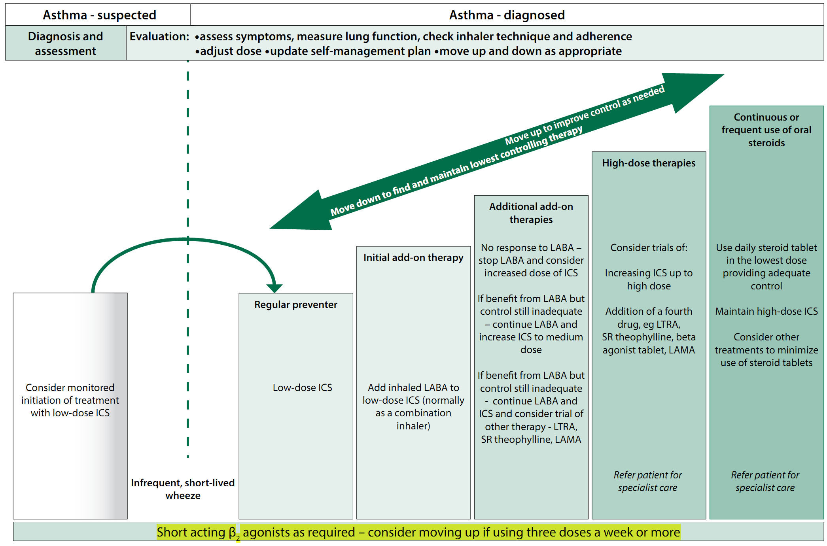
LAMA =Long acting antimascarin like Ipratropium
LTRA = Leukotriene receptor antagonist like monaleukast
MDI= metered dose inhalor like salbultamol inhalar
LABA= long acting beta 2 agonist like salmetrol

Slide 7
